Slide 1



Integral Biomarkers in Clinical Trial Design and Conduct:
The Experience of CCTG IND 234
NICTC Meeting, Queen’s University
3rd August 2022
Dr. Alexander W Wyatt, D.Phil
Assistant Professor, University of British Columbia
Senior Research Scientist, Vancouver Prostate Centre
Scientist, Canada’s Michael Smith Genome Sciences Centre, BC Cancer
Twitter @ResearchWyatt

Slide 2
Disclosures
I have served on advisory boards and/or received honoraria from AstraZeneca, Astellas, Janssen, and Merck.
My laboratory has a contract research agreement with ESSA Pharma
No other relationships/conditions/circumstances that present a potential conflict of interest

Slide 3
My history as a PhD clinical trialist!
Website: blogs.ubc.ca/wyattlab
Twitter: @ResearchWyatt
Background: PCa genomics and bioinformatics; urologic oncology
2015-17: faculty appointment
  Goal: understand clinical-relevance of genomic alterations in met PCa
  Published early data supporting ctDNA for genotyping mCRPC
Worked with Kim Chi to integrate plasma cfDNA collections in pivotal trials for mCRPC (Khalaf, Lancet Oncol 2019; Annala, Ann Oncol 2021)
  Correlatives enabled multiple publications, trainee projects, grants
  Exposure to practical aspects of trial execution, biobanking
2017-18: with Chi and @CCTG (L. Seymour), launched prospective mCRPC precision oncology trial using ctDNA
  Insight into co-op group operations, practicalities & industry relationships

Slide 4
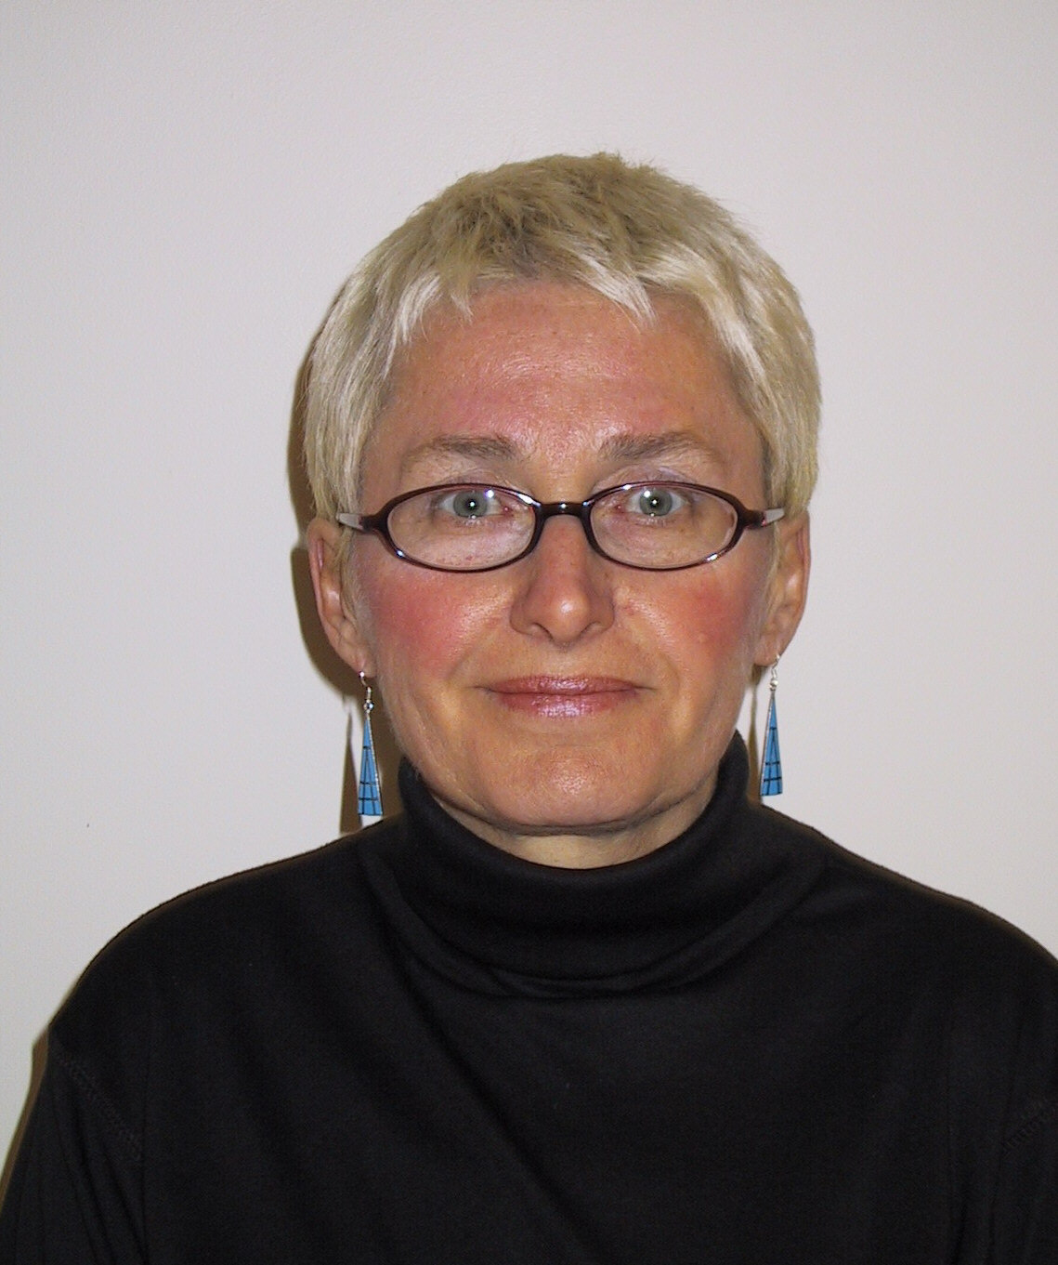
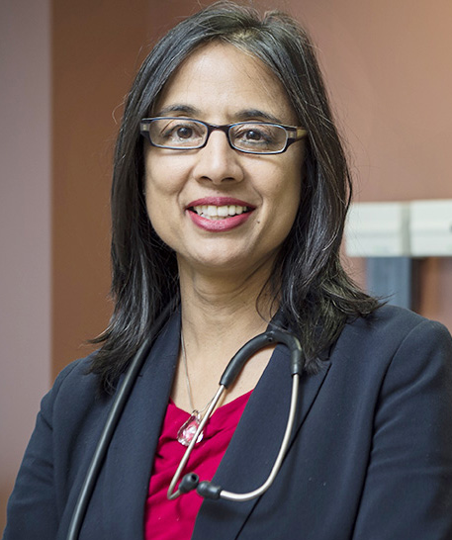
My history as a PhD clinical trialist! Part 2...
2018: member of CCTG trial development committees (GU & IND)
  Exposure to varied concepts. New relationships. Influence on correlatives.
Prof. Lesley Seymour
Prof. Wendy Parulekar

Slide 5
My history as a PhD clinical trialist! Part 2...
2018: member of CCTG trial development committees (GU & IND)
  Exposure to varied concepts. New relationships. Influence on correlatives.
2018-20: development of multiple prospective biomarker trials
  Including from concept to first patient (e.g. PROTRACT NCT04015622)
2020-21: ANZUP translational research steering committees
  Opportunity to influence correlative science in other countries
  Increases impact of home trial correlatives
2021: Correlative Chair for GU disease site @CCTG
  Embed cfDNA and other collections in all appropriate new trials

Slide 6
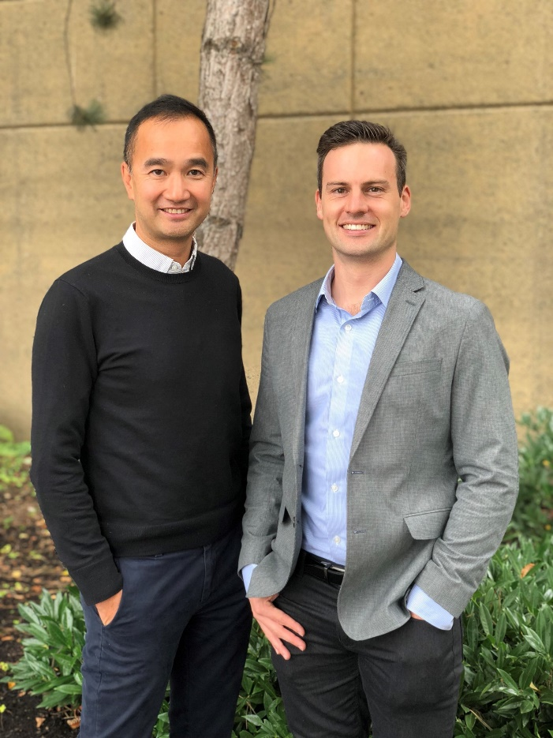
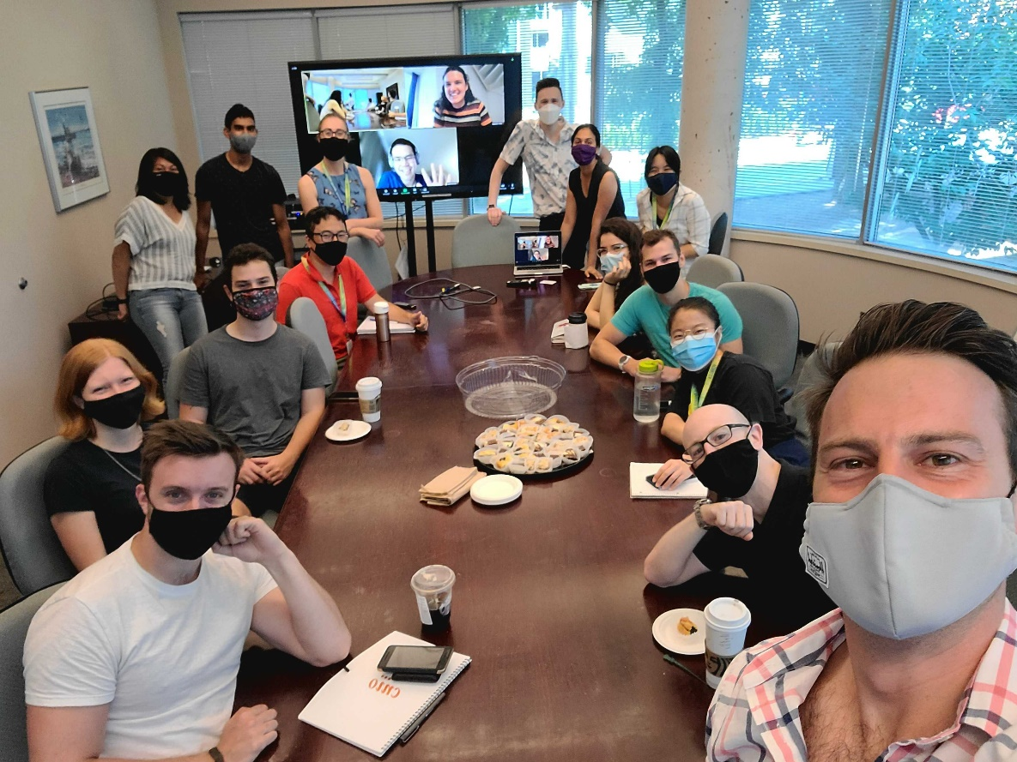
Plasma ctDNA research in British Columbia
…plus a dedicated clinical research network, including oncologists, nurses, coordinators
The UBC / Vancouver Prostate Centre / BC Cancer ctDNA research team – mostly computer scientists / data analysts
Photo: July 2021
Dr Kim Chi, responsible for collection of over 3500 plasma ctDNA samples from pts with prostate cancer

Slide 7






Several types of biomarkers in cancer
Risk | Diagnostic | Prognostic | Predictive | Response | Safety
Identify cancer susceptibility | Indicate type of cancer | Estimate cancer aggression | Predict efficacy from treatment | Monitor therapy benefit | Indicate toxicity from treatment
Inherited mutations in BRCA2 | Tissue biopsy pathology | Extent of disease by Imaging (CT, MRI, PET) | HRR gene mutations | PSA decline | Patient reported side-effects
Goal
Example
Cancer alterations are not always simple to identify or characterize
Cancer biology is complex and cannot always be reduced to biomarker ‘positive’ vs ‘negative’

Slide 8
Metastatic cancers have an increasingly complex treatment landscape
Decades of basic and clinical research = new systemic therapies
  Chemotherapies
  Immunotherapies
  Targeted therapies
Ongoing clinical trials of new targeted therapies and combinations of therapies = more complexity coming
Not all patients derive benefit from all treatments
Need for ‘biomarkers’ to predict disease response to treatment
To help us practice precision medicine and individualize clinical management

Slide 9
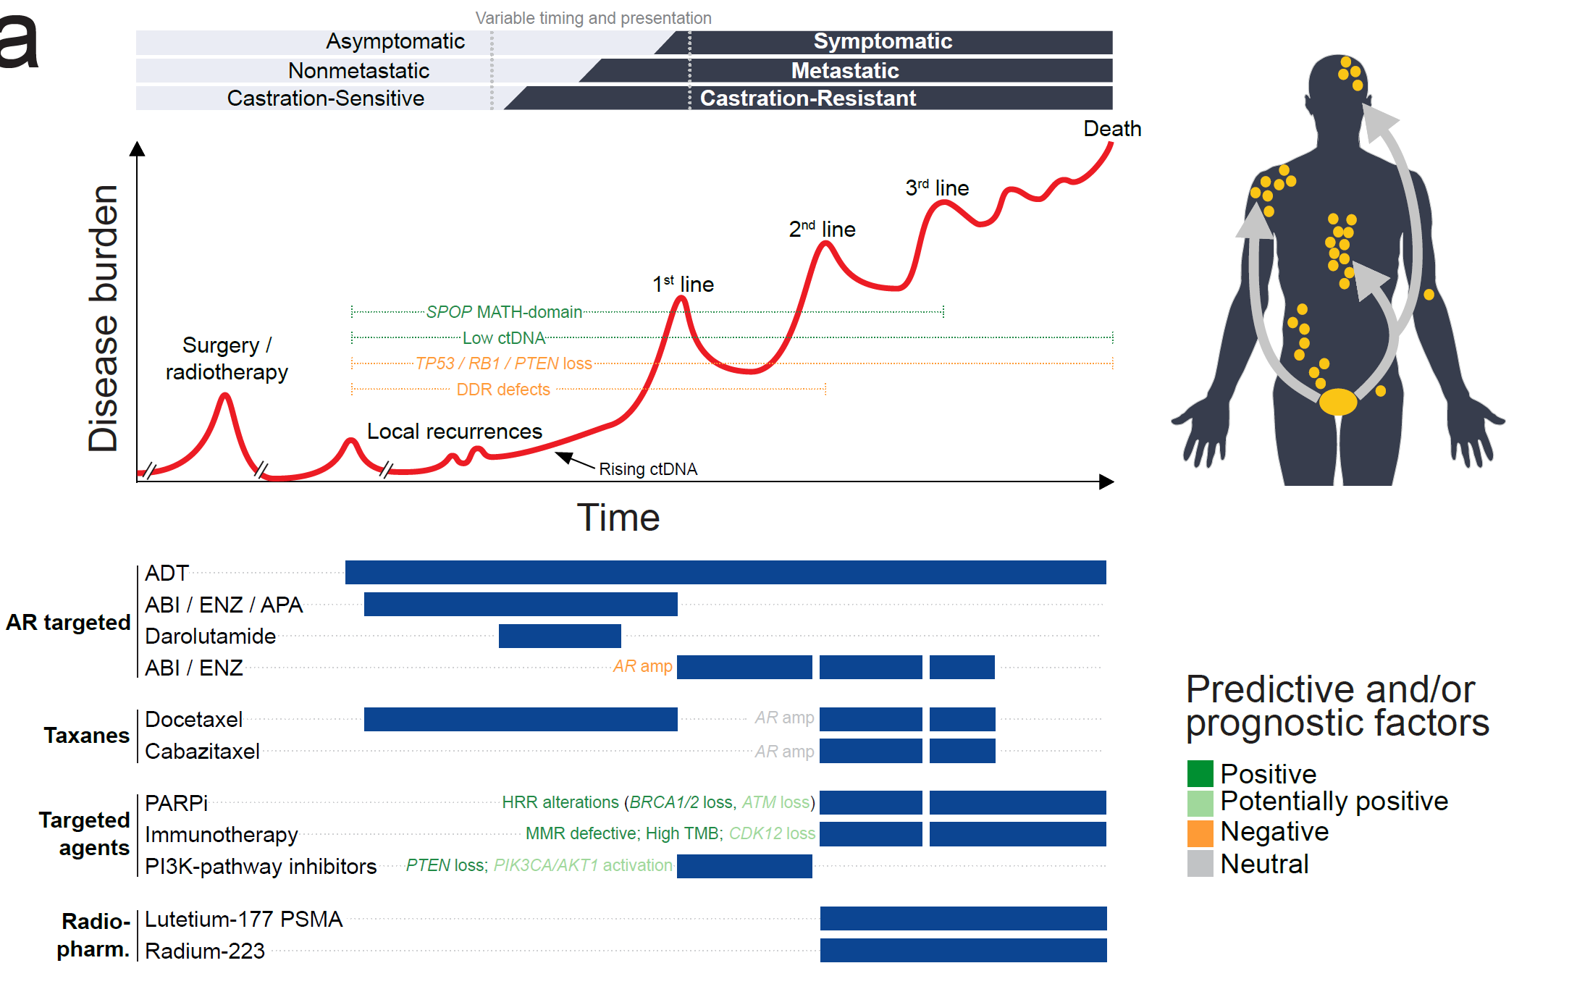
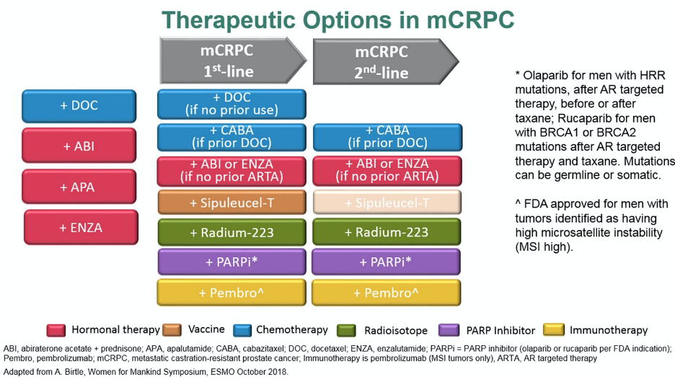
Metastatic cancers have an increasingly complex treatment landscape
Metastatic prostate cancer is a strong example

Slide 10
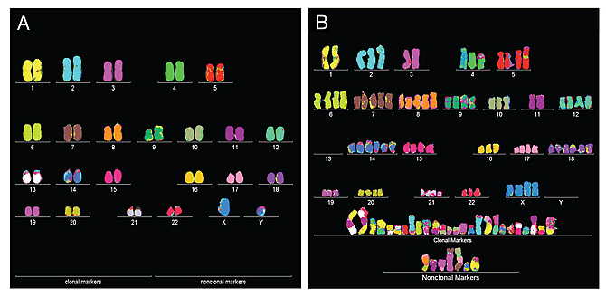
Cancer is a disease of the genome
Mutations to the DNA can result in a proliferative cancer cell
The whole genome is often remodelled in advanced disease
Normal chromosomes in a cell
Example cancer cell chromosomes
Sanders R. “Are cancers newly evolved species?” Berkley News. Available at: https://news.berkeley.edu/2011/07/26/are-cancers-newly-evolved-species/ [Accessed January 2021].

Slide 11
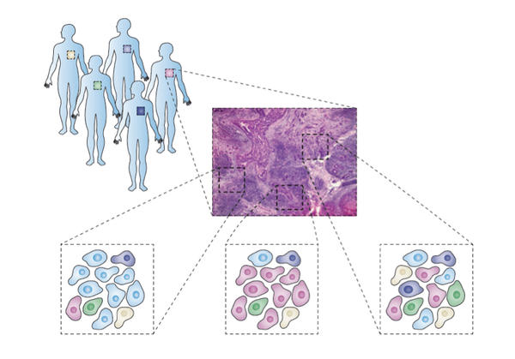
Tumour and host ‘heterogeneity’ helps explain differential therapy response
Each cancer and person is different at the genome level (and every other level)
This can modulate therapy response
Particular relevance for new targeted therapies – the ‘target’ must be present!
Image by Simona Cristea, Dana-Farber Cancer Institute

Slide 12
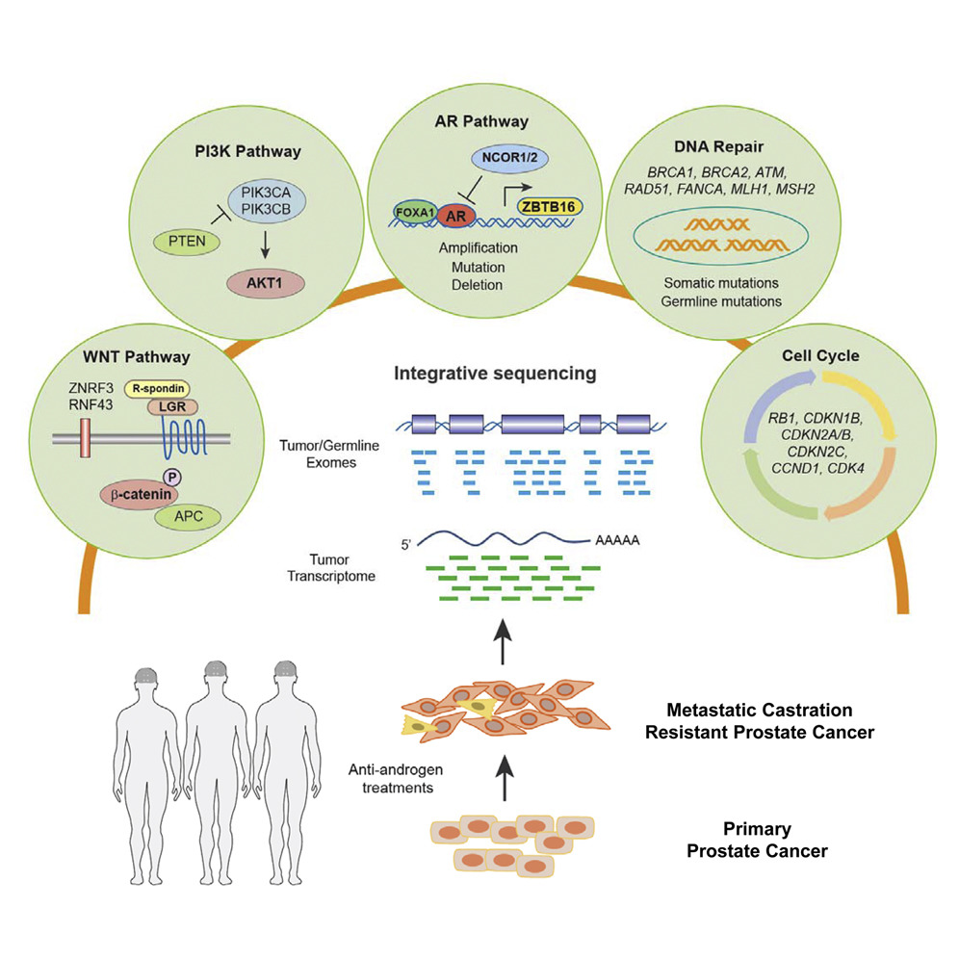
Genomic heterogeneity of metastatic prostate cancer – therapeutic vulnerabilities?
Correlative studies: different genomic alterations associate with different disease prognosis
Several consensus clinical guidelines now recommend germline +/- somatic screening of DNA repair genes
hereditary cancers
patient prognosis
treatment selection
Robinson et al. Cell 2015

Slide 13
Emerging genomic biomarkers in metastatic prostate cancer
PARP inhibitors approved in North America for mCRPC with selected homologous recombination repair (HRR) gene alterations
Herberts, Trends in Cancer 2021

Slide 14
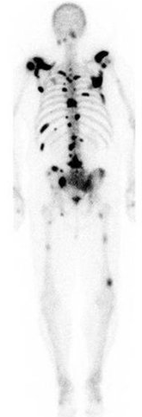
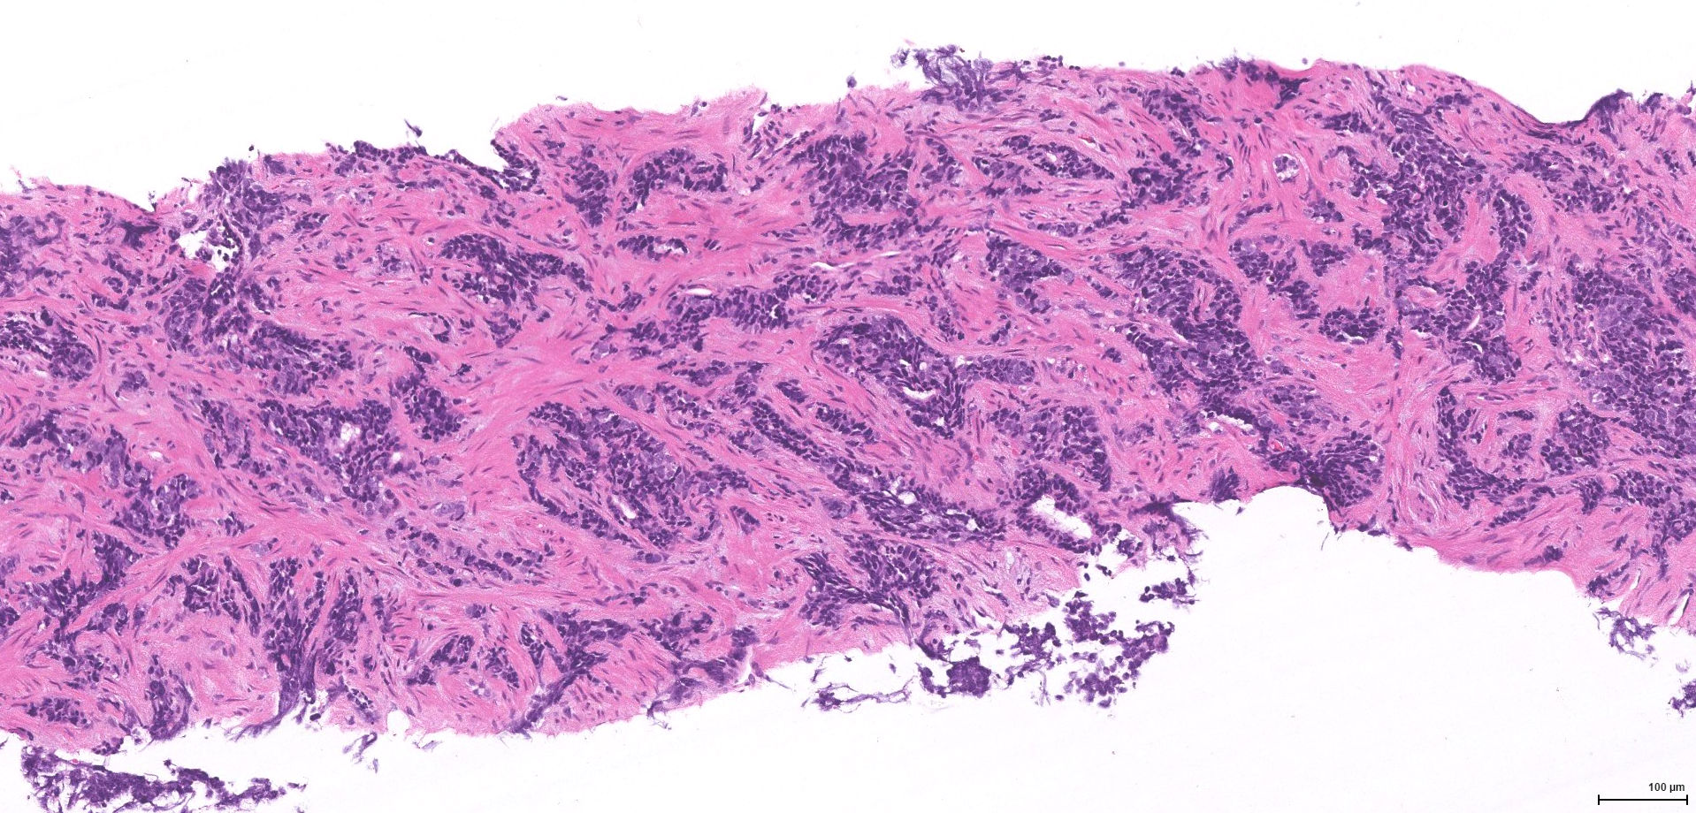
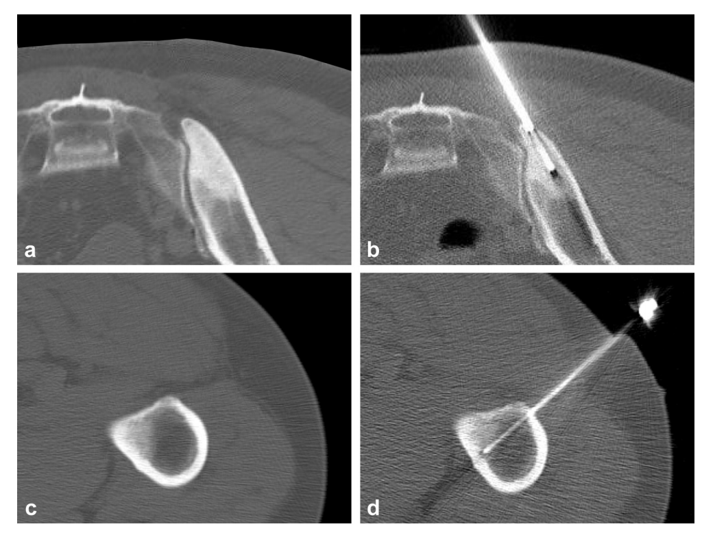
Historical sources of genomic biomarkers
Whole blood testing (or saliva / cheek swab)
  Informs only on germline (e.g. BRCA2 mutations)
Tissue testing (fresh tumour biopsy, archival diagnostic material)
  Informs on germline and somatic alterations
  Archival tissue profiling is not possible / fails in 30 – 40% of patients
Metastatic tissue biopsy will not become routine
Vandekerkhove et al. Cancer Genetics, 2018; Holmes et al. J Vasc Interv Radiol 2017

Slide 15
Addressing the clinical challenge in mCRPC
Great advances in systemic therapy for mCRPC
Improved understanding of molecular landscape
Lack of predictive biomarkers beyond BRCA2/BRCA1/MMRd (?ATM/ PTEN)
  Lack of routine metastatic tissue biopsy
  High rates of archival diagnostic tissue sequencing failure
  Difficulty enriching cohorts for potential responders with rare alterations
IND223/234: Can we use cell-free DNA to robustly genotype mCRPC towards biomarker-driven treatments and improve clinical outcomes?

Slide 16

What is circulating tumor DNA (ctDNA)?
Short fragments (post-apoptotic) of tumor-derived DNA in the blood
Mixed with cell-free DNA from non-cancer cells (leukocytes)
Half-life = hours
CtDNA abundance is associated with proliferative tumor burden
?

Slide 17
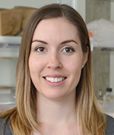

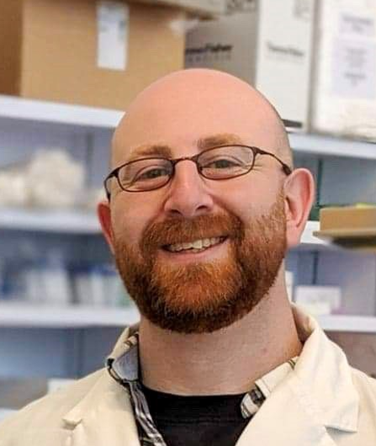
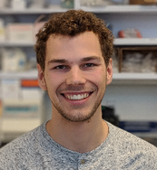
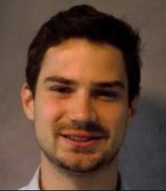
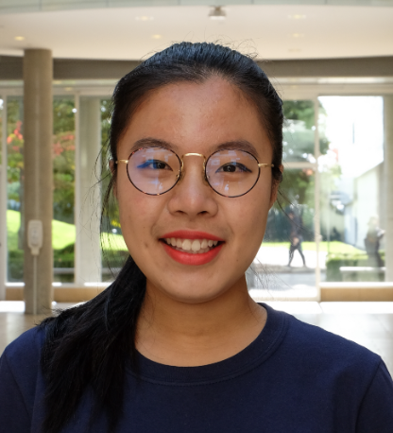
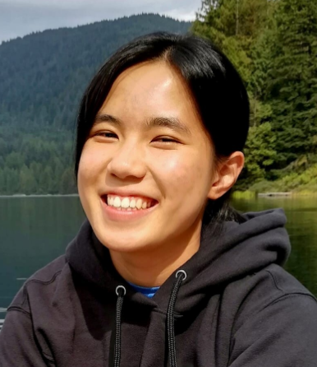

Genomic alterations in ctDNA are an emerging tool to guide clinical practice
ctDNA resolves somatic genotypes
Wyatt et al., JAMA Onc 2016; Annala et al., Eur Urol 2017; Herberts et al., Eur Urol 2020
Synchronous ctDNA vs. tumour tissue = highly concordant
Wyatt et al., J Natl Cancer Inst 2017; Vandekerkhove et al., Eur Urol 2019
Tumor suppressor loss and aggressive AR alterations = poor prognosis
Annala et al., Cancer Discov 2018; Annala et al., Clin Cancer Res 2021
DNA repair defects in ctDNA associate with differential outcomes
Ritch et al., Clin Cancer Res 2020; Warner et al., Clin Cancer Res 2021
ctDNA informs tumour evolution and therapy resistance
Annala et al., Clin Cancer Res 2021; Quigley et al., Cancer Discov 2017
Figure by Cameron Herberts
Matti Annala, University of Tampere
@UBC bioinformatics students

Slide 18
Concordance for ctDNA vs matched tissue is relatively high, but ctDNA% dependent
Practical limits of de novo detection with large panels are 0.5 - 1% ctDNA for mutations, but as high as 10 - 20% for some copy number changes
Similar gene copy numbers, ctDNA vs tissue
Similar mutation profiles, ctDNA vs tissue
Wyatt et al., J Natl Cancer Institute 2017; Vandekerkhove et al., Eur Urol 2019

Slide 19
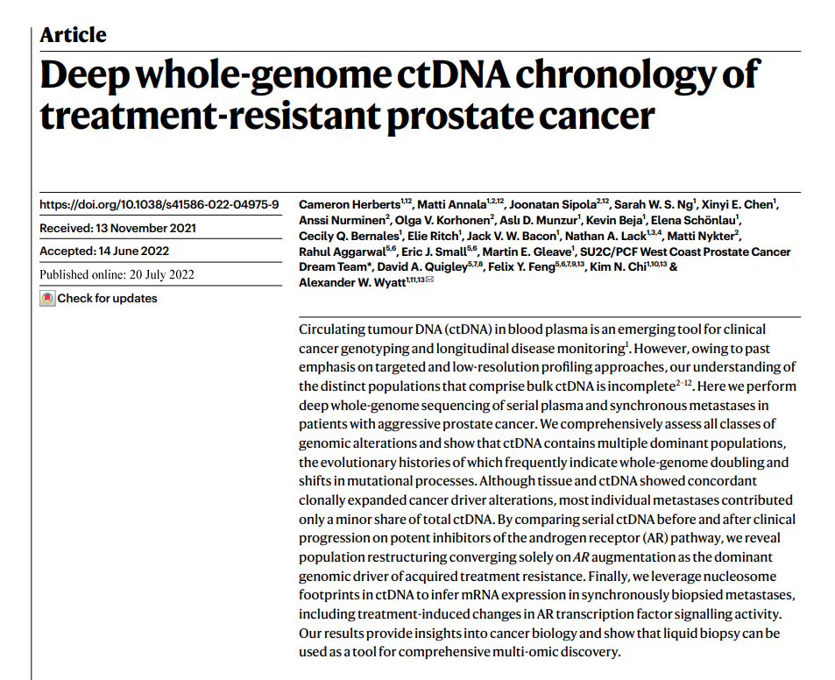
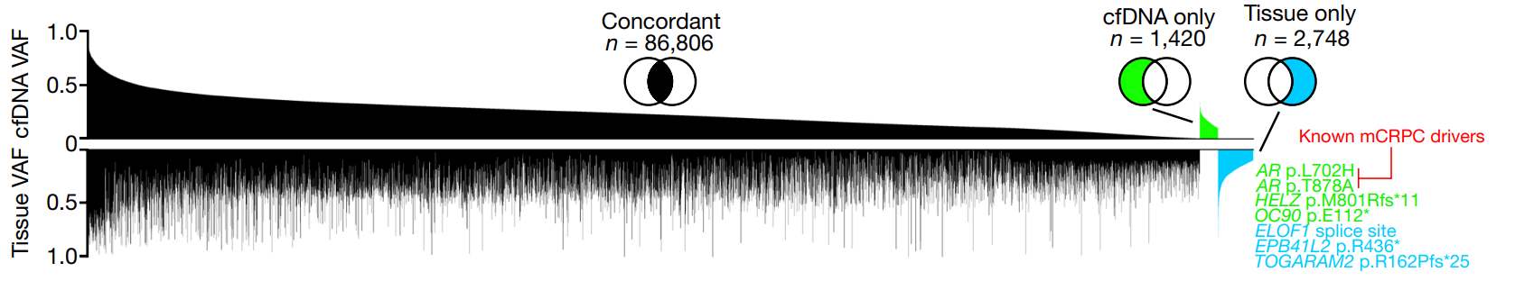
Herberts et al., Nature 2022

Slide 20
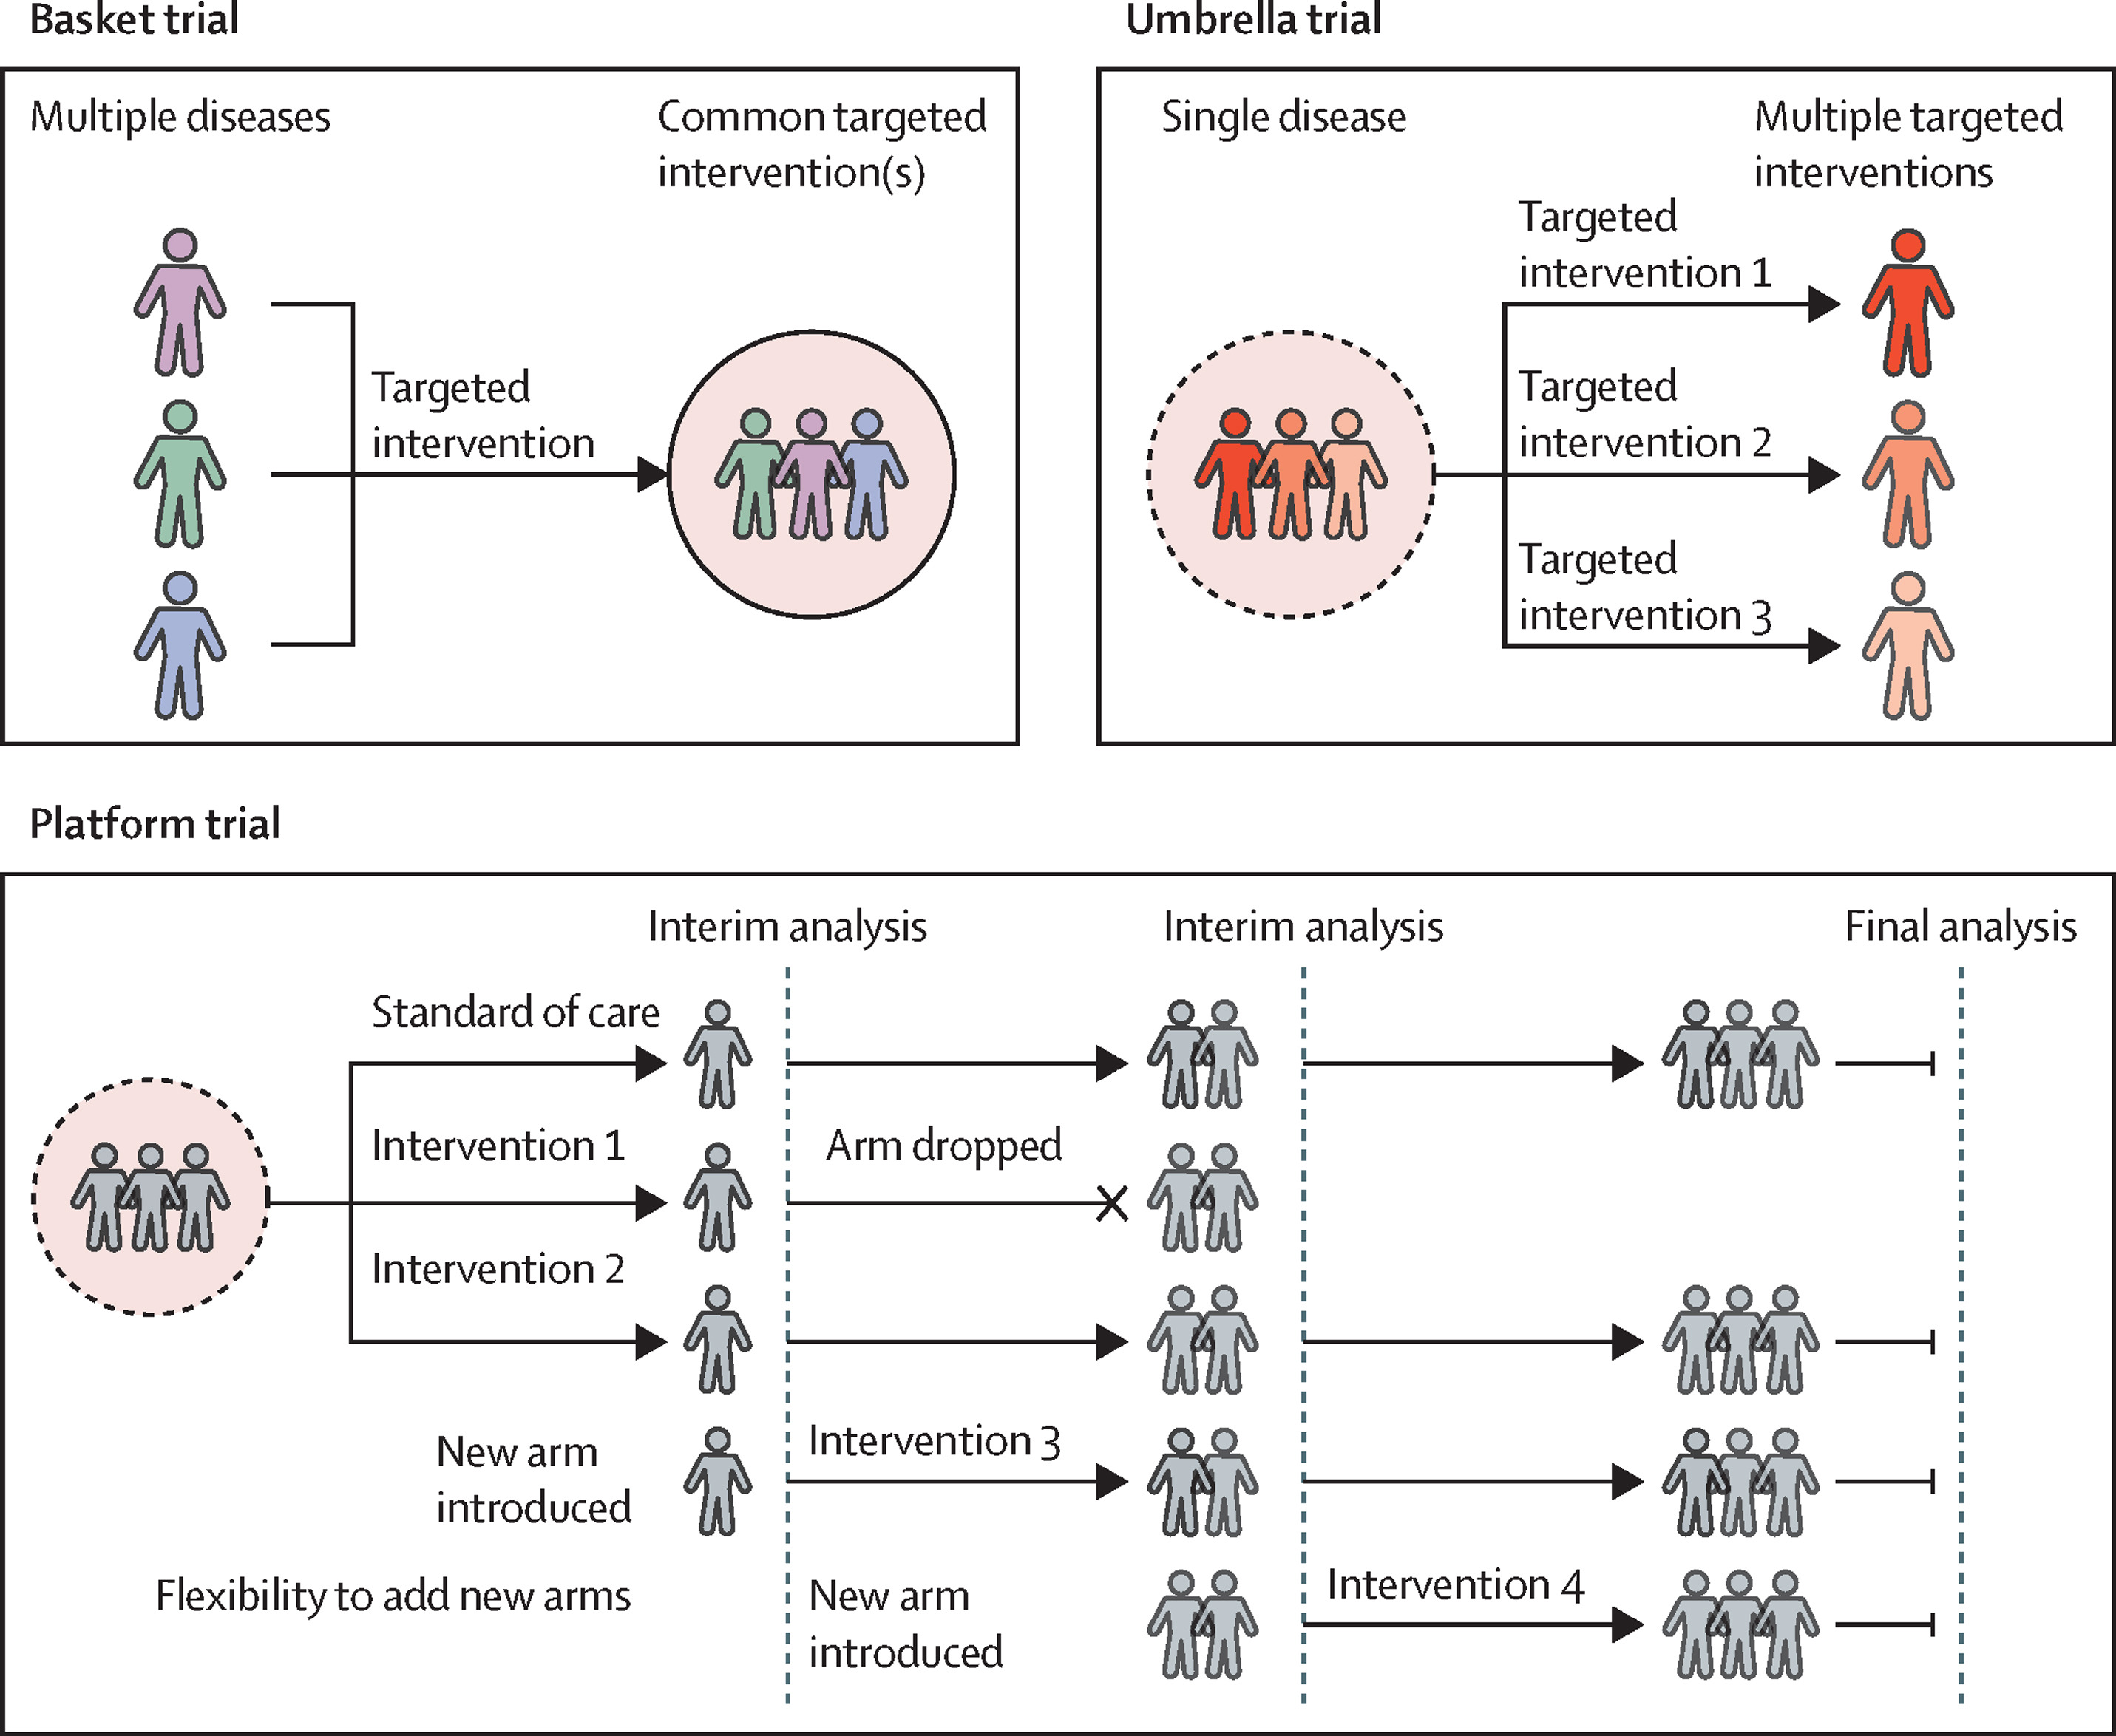
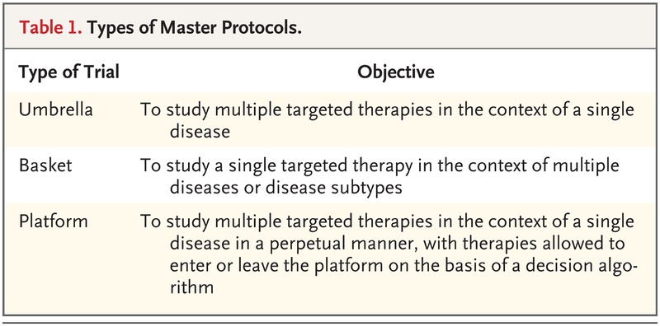
Towards a platform trial leveraging ctDNA

Slide 21


Prostate cancer biomarker enrichment and treatment selection (PC-BETS) study
Open-label multicentre 2-stage biomarker-driven phase II umbrella trial
Chairs: Kim Chi, Lesley Seymour
Sub-study PIs & entire CCTG team
ClinicalTrials.gov: NCT03385655 (“IND234”)

Slide 22
Prostate cancer biomarker enrichment
and treatment selection (PC-BETS) study
> 500 mCRPC patients screened to date
Chairs: Kim Chi, Lesley Seymour
Sub-study PIs & entire CCTG team
ClinicalTrials.gov: NCT03385655 (“IND234”)

Slide 23
Study Design: endpoints
Primary = Clinical benefit rate defined as proportion of patients who had PSA decline ≥ 50%, complete or partial objective response, or Stable disease for ≥ 12 weeks.
Secondary
  Measure effect of each study drug on PSA decline
  Measure objective response as determined by RECIST 1.1 criteria
  Number and severity of adverse events
  Measure effect of each study drug on time to PSA progression
  To summarize progression-free survival
  To summarize overall survival

Slide 24
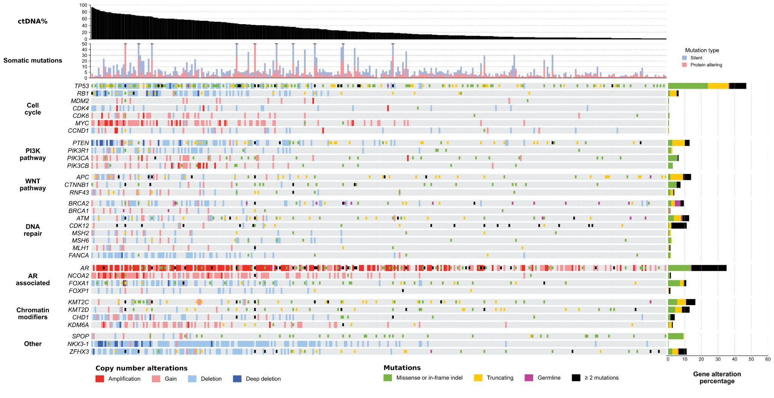
Alterations in target genes for prospective treatment assignment
Unpublished analysis by Dr. Edmond Kwan, Wilson Tu, Matti Annala

Slide 25
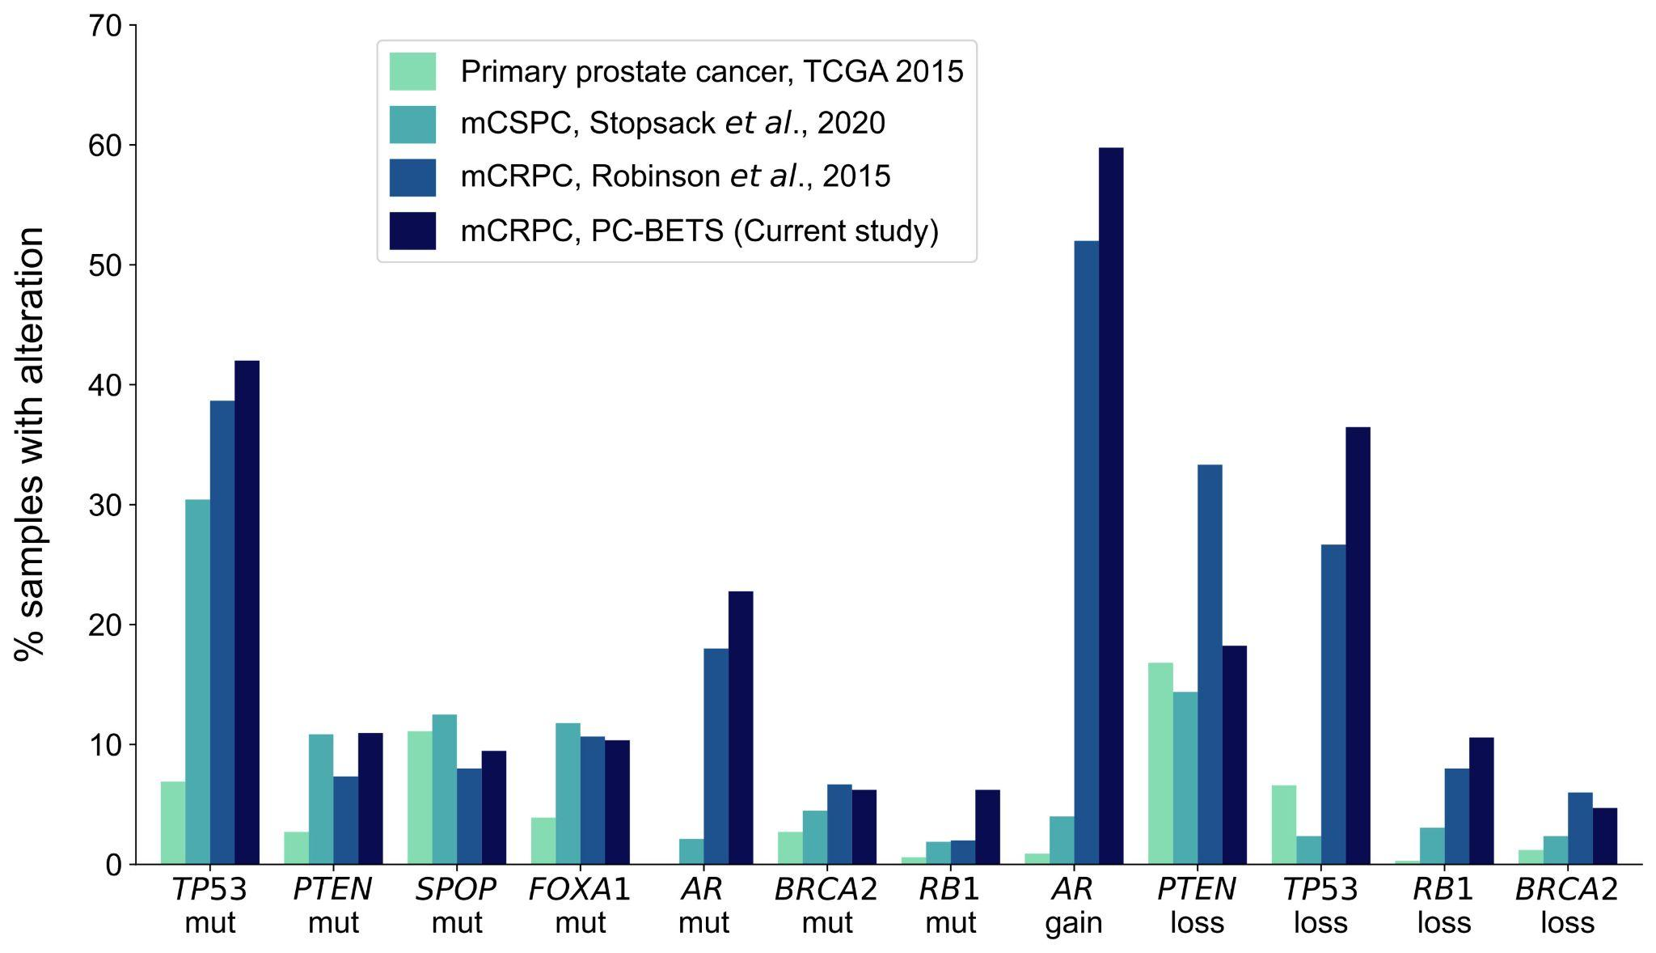
Very similar frequency of genomic alterations to published mCRPC studies using metastatic tissue
Unpublished analysis by Dr. Edmond Kwan, Wilson Tu, Matti Annala

Slide 26
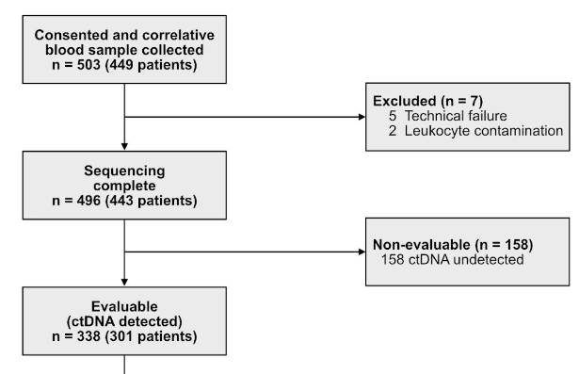
Lesson #1: Be aware of the potential biases of your screening approach
Patients with very low ctDNA% cannot be assigned to treatment arms!

Slide 27
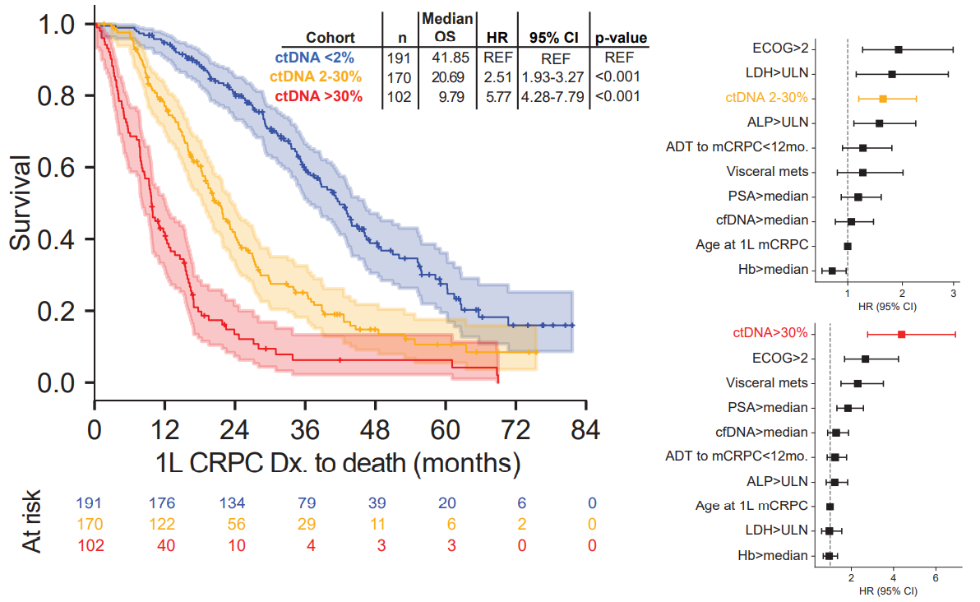

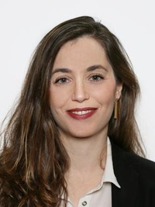

ctDNA% is an independent prognostic marker
Newly progressing mCRPC (n = 463)
Blood collection 1 – 30 days prior to 1L tx
Unpublished
Dr. Nicolette Fonseca, Dr. Corinne Maurice-Dror, Cameron Herberts

Slide 28
Lesson #1: Be aware of the potential biases of your screening approach
Patients with very low ctDNA% cannot be assigned to treatment arms!
Our design actively excludes the patients with the best prognosis from our trial!

Slide 29
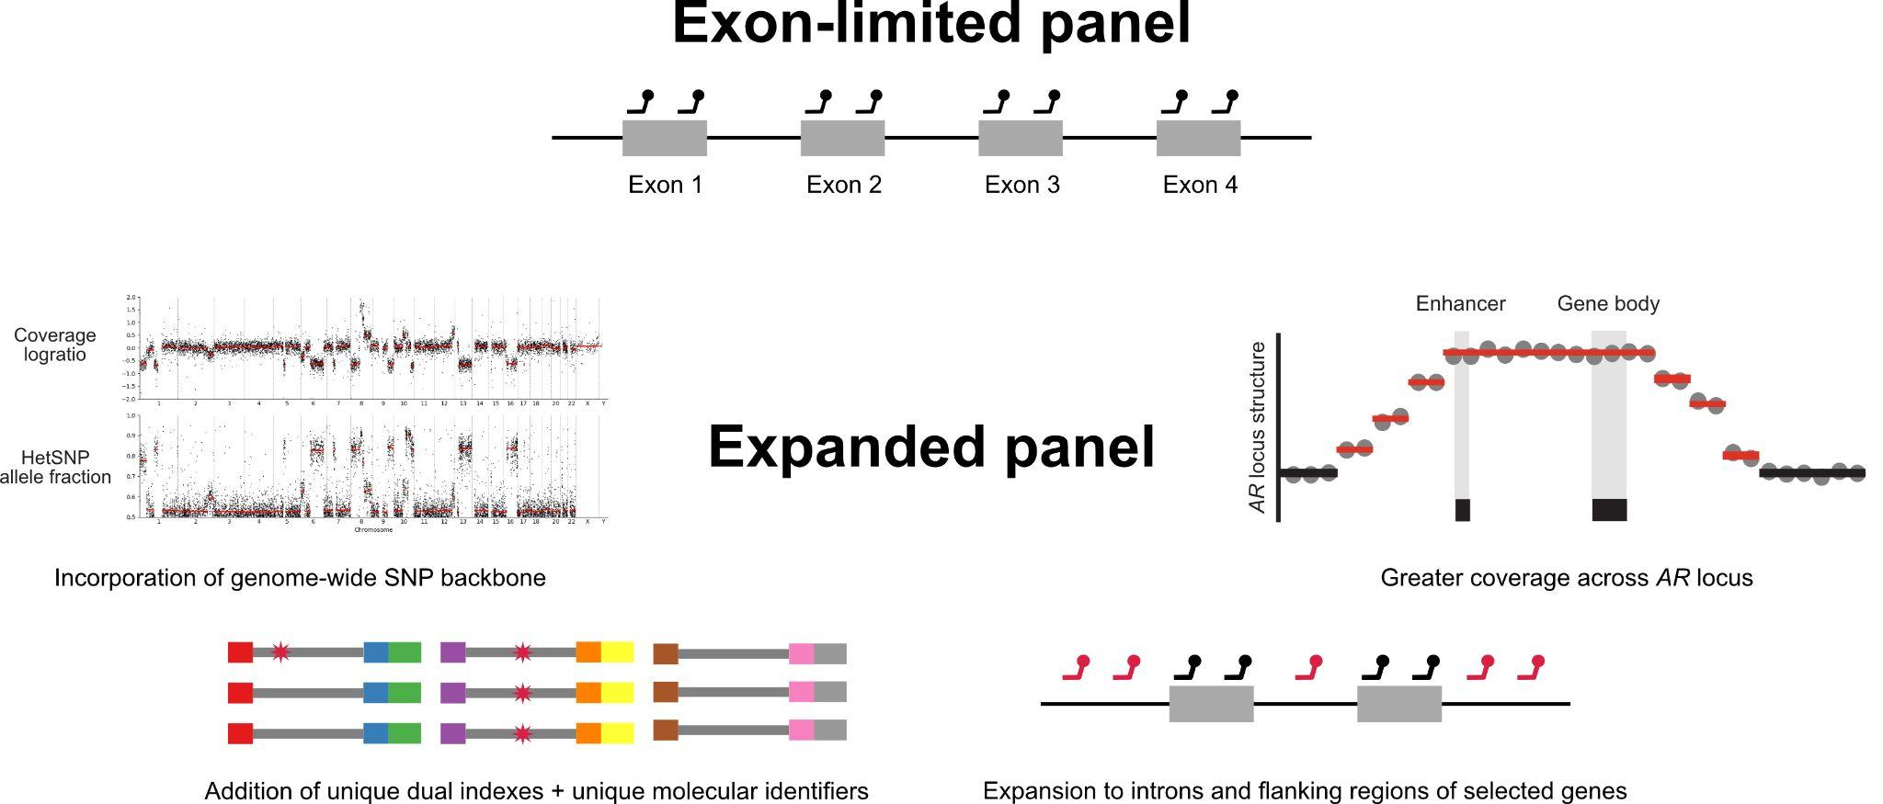
Lesson #2: Genomic assays improve over time (literature, new H¹)
Original panel only covered exons and would miss genomic structural rearrangements that fell in introns and regulatory regions

Slide 30
Expanded targeted panel permits identification of more complex genomic alterations

Slide 31
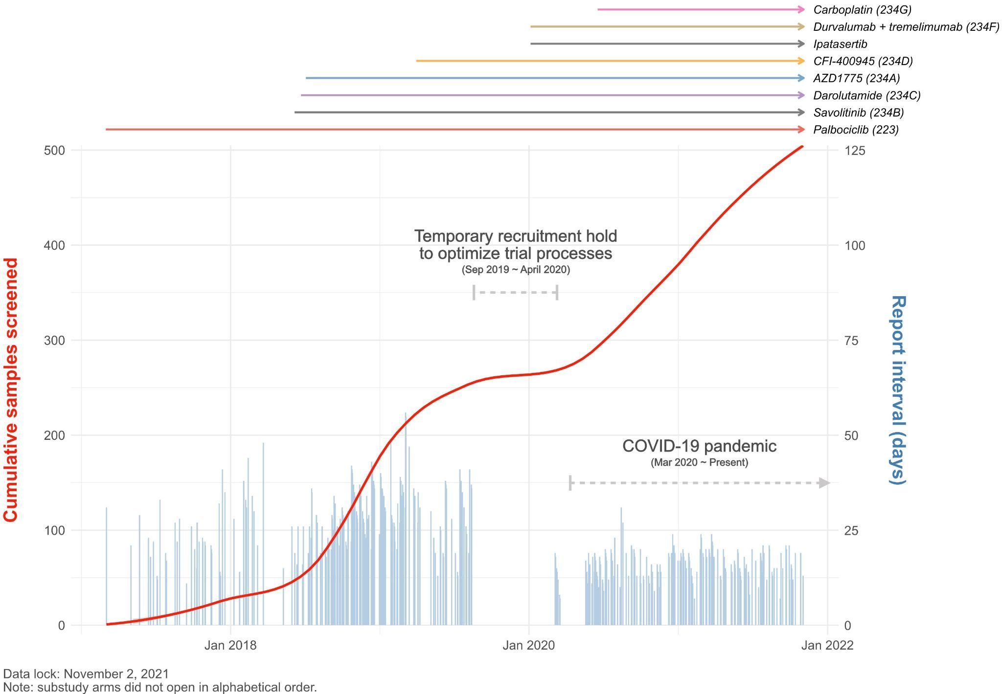
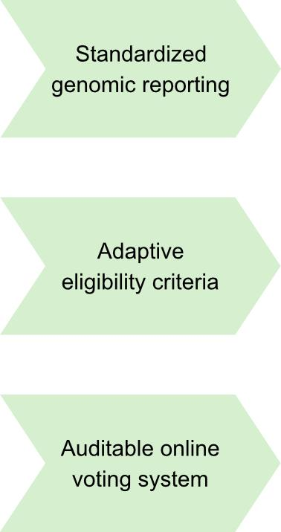
Second generation assay and optimized reporting process resulted in faster screening

Slide 32
Lesson #2: Genomic assays improve over time (literature, new H¹)
Original panel only covered exons and would miss genomic structural rearrangements that fell in introns and regulatory regions
Early patients have less ‘comprehensive’ genomic annotation compared to later patients

Slide 33
Lesson #3: Genomic eligibility is complex and needs to be adaptive
Not all arms were open simultaneously
Patients can be eligible for multiple arms
Literature can indicate new vulnerabilities

Slide 35
Lesson #3: Genomic eligibility is complex and needed to be adaptive
Develop an adaptive ‘algorithm’ for arm assignment, based on tumour board precedent
Not all arms were open simultaneously
Patients can be eligible for multiple arms
Literature can indicate new vulnerabilities

Slide 36
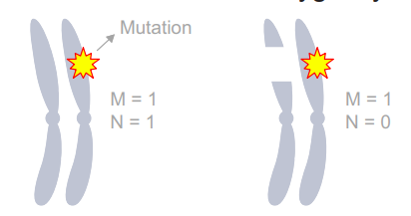
Lesson #4: Genomic biomarkers are highly nuanced
mutation
Copy loss (deletion)
Many types of alterations in the same genes
Oncogenic redundancy
Subclonal alterations

Slide 37
Mutations are just one mechanism of genomic alteration
Some tests will report a tumor suppressor gene mutation but not a heterozygous (monoallelic) deletion
Key prostate cancer tumor suppressor genes RB1, TP53, PTEN can be disrupted by single copy losses or complex structural rearrangements
mutation
Copy loss (deletion)
Herberts and Wyatt, Trends in Cancer 2021

Slide 38
Gene amplification is not a binary variable
Copy number gain is a continuous spectrum from low to high
Absolute copy number can be biologically relevant
Annala et al., Clin Cancer Res 2021

Slide 39
Lesson #4: Genomic biomarkers are highly nuanced
Perform detailed genomic re-analysis with outcomes; consider additional correlatives
mutation
Copy loss (deletion)
Many types of alterations in the same genes
Oncogenic redundancy
Subclonal alterations

Slide 40
Commercial assays are adequate for mutation detection (at >1% variant allele frequency)
We subjected cfDNA from 24 clinically progressing patients to parallel Guardant360 and in-house targeted sequencing
We independently confirmed 94% of somatic mutations identified by Guardant360 at >1% allele fraction.
Caveat: many somatic mutations identified by Guardant360 at <1% allele fraction appeared to represent subclonal passenger events or non-prostate derived clones.
Taavitsainen, Sartor, et al., JCO Precision Oncology 2019

Slide 41
Utility is limited by inadequate reporting on deletions, rearrangements, and germline
E.g. several clinically relevant DNA repair gene alterations were not reported by Guardant360, including germline and somatic truncating BRCA2/ATM mutations, BRCA2 biallelic deletion, BRCA2 reversion mutations and a hypermutator phenotype (MMRd)
Taavitsainen, Sartor, et al., JCO Precision Oncology 2019

Slide 42
Limits of detection in selected cfDNA assays
Guardant360 CDx
  BRCA1/2 indel = 0.4 – 2.6% VAF (depending partly on cfDNA input volume)
  “Somatic alterations in ATM and CDK12 are not reported by the test as they are excluded from the test's reportable range.”
  Does not report copy losses
FoundationOne Liquid CDx
  BRCA1/2 or ATM indel = 0.36 – 0.51% VAF
  BRCA2 copy number loss = 48.1% TF (ctDNA fraction)
    Median LoD is 30.4% TF for copy losses across the panel
Remember: For non-recurrent alterations, LoD are rough estimates (at best). Sequence context (e.g. GC-content), mutation/deletion size, aneuploidy, input amount, etc – have a big effect

Slide 43
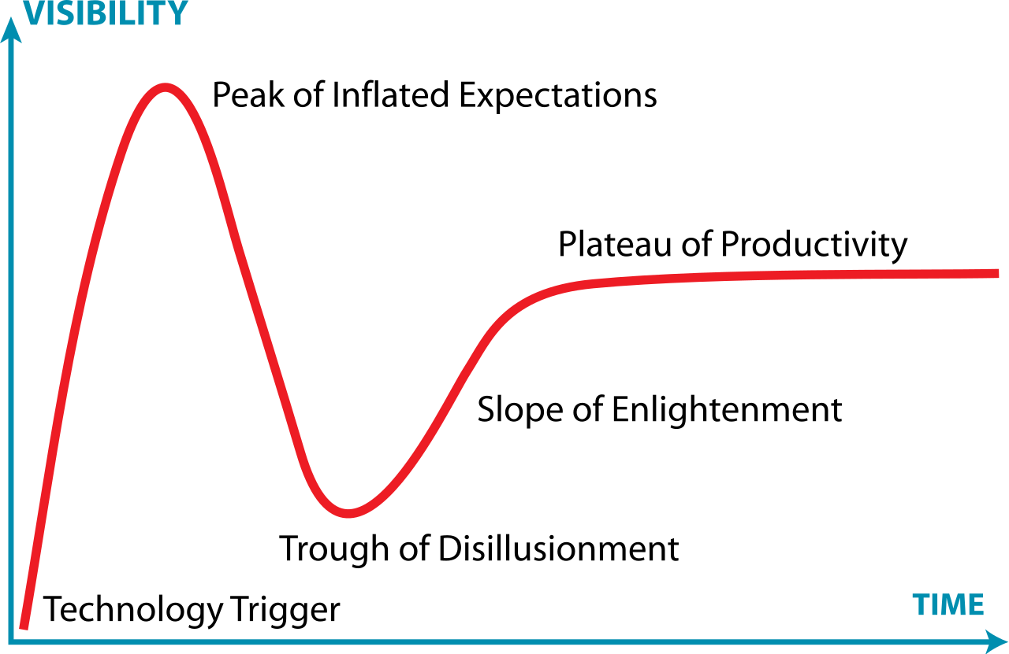
The hype cycle for new technology
ctDNA-based cancer genotyping is following the classic hype cycle
What triggered disillusionment?
False negatives (low ctDNA%)
False positives (CHIP)
No germline discrimination
Opaque test limits
Inadequate reporting of copy loss
Non-comprehensive assay designs
Poorly timed blood collections
Poor education of all the above
These challenges can be solved!
Graph modified from original by Jeremykemp at English Wikipedia, CC BY-SA 3.0, https://commons.wikimedia.org/w/index.php?curid=10547051

Slide 44
Conclusions
CCTG IND234 (and 223) represents the first prospective umbrella clinical trial in mCRPC to use plasma ctDNA as a screening tool
We successfully screened ctDNA from >500 mCRPC patients across Canada over a 4-year period
Genomic platform trials must be nimble to latest scientific breakthroughs: need adaptive assay design and genomic eligibility
Commercial genomic tests do not yet accurately capture the complexity of cancer and are having limited success in directing tx
Biomarkers will not rescue a drug that does not work

